Slide 1

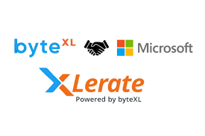
HUMAN PATIENT MANAGEMENT SYSTEM
TEAM MEMBERS:
24KB1A0455:CH.NAVYASRI-ECE-C
24KB1A0430:B.SRAVANTHI-ECE-C
24KB1A0402:A.BHUVANESWARI-ECE-C
24KB1A04AF:T.JHANSI-ECE-C
24KB1A0471:C.GAGANASRI-ECE-C
24KB1A04C4:I.SIREESHA-ECE-C

Slide 2
Introduction:
The Hospital Patient Management System is a software solution desgined to manage hospital patient records efficiently.
Devoloped using C programming and fundamental data structures like arrays,linked lists,stacks,andqueues.
aims to simplyfy tasks such as patient registration,appointment scheduling and record retrieval.

Slide 3
Previous system:
Manual record-keeping using paper files,
Excel sheets or basic database programs with limited features.
Some used general-purpose tools not tailored to healthcare management .

Slide 4
Drawbacks of previous systems:
Time –consuming prone to human error.
Lack of data security and privacy.
Difficult to search,update,or track records efficiently.
No central system for managing patient histories appointing, and
doctor assignments .

Slide 5
Project objective:
To create a simple ,efficient and structured system for managing
hospital patients.
Use data structures to handle:
patient registration(linked list)
Queue management for appointments.
Stack or array for medical histories
Provide faster access, better organization, and easy updates of patient data.

Slide 6
System overview:
Store patient details using linked lists.
Uses queues to manage patient appointment scheduling.
Medical history for each patient can be stored an accessed using stacks
or nested linked lists.
fast search functionalities for patient records based on ID or name.
Admin can generate reports, manage records, and view appointment status.

Slide 7
technologies and tools:
language: C
Concepts: arrays, linked lists, queues, stacks.
Storage: file handling for saving records.
Platform: command-line interface.

Slide 8
Working flow:
Start the application
Patient registration
Appointment scheduling
Medical history management
Search and retrieve patient record
Update/delete patient record
Display appointments
Exit and save

Slide 9
Modules in project:
Patient registration module
Appointment scheduling module
Patient search module
Medical history management
Billing and payment module
Doctor management module
Discharge and record deletion
Reports module

Slide 10
Advantages:
Efficient record handling using structured data.
Faster search and retrieval of patient information.
Improved accuracy and reduced manual effort.
Can be scaled or integrated with databases in the future.

Slide 11
Challenges:
Managing memory dynamically in c
Ensuring data integrity without built-in database support.
Handling edge cases like duplicate entries or corrupted input.
Designing a user-friendly interface within a C console application.

Slide 12
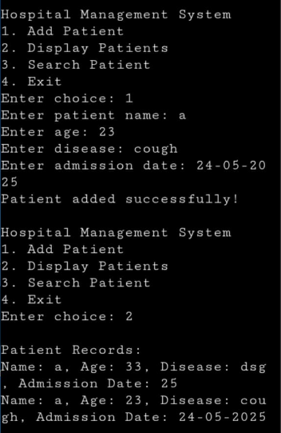
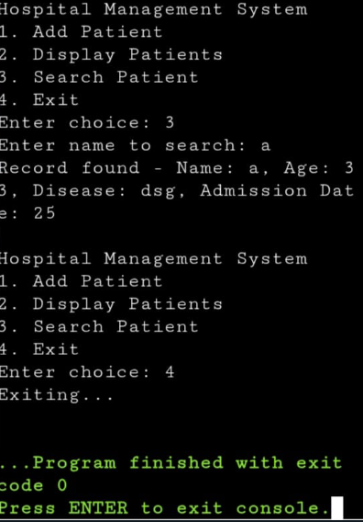
Output images:

Slide 13
Conclusion:
The project demonstrates the practical application of data structures in C for
real-world problems.
It offers a basic yet functionality model for hospital patient management.
Can be enhanced with GUI, database integration, and more features in future
versions.

Slide 14
THANK YOU

